Slide 1
AN EXPERT SCORECARD SYSTEM FOR
EMPLOYEE PERFORMANCE TRACKING
RESEARCH AREA :EMPLOYEE PERFORMANCE
CASE STUDY:MUST
MUGABI PRAISE : 2021/BSE/074/PS
BYARUHANGA ISAMEL : 2021/BSE/043/PS
ATWIINE ACHIEVER : 2021/BSE/031/PS
MUTUNGI FELIX : 2021/BSE/187/PS
Faculty of Computing and Informatics
Department of Software Engineering
Notes:
<number>

Slide 2

Introduction
Efficient and accurate assessment of employee performance is paramount to organizational success(George,Zibasa, 2020)
Ensures that the right people are in the right positions
Facilitates career growth by identifying strengths and development areas(Tomczak et al 2018)
Need to improve efficiency, accuracy, and transparency of employee performance assessment at MUST.
Notes:
The tea industry has the potential to play a major role in achieving the sustainable development goals(SDGs) through;
Zero Hunger (SDG 2)
Good Health and Well-being (SDG 3)
Decent Work and Economic Growth (SDG 8):
This represented 2.8 percent of Uganda's total exports, 1.26 percent of global tea exports and
0.36 percent of Uganda's Gross Domestic Product (GDP).
More than 67% of Uganda's tea is grown by small holder farmers under low-input systems [7]

Slide 3
Problem Statement
The current system for assessing employee performance at MUST is manual
Data Redundancy – time consuming.
Lack of Feed back
Prone to errors – data inconsistency, wrong assessment.

Slide 4
Main Objective
To design an expert scorecard that can track employee performance at Mbarara
University of Science and Technology.

Slide 5
Specific objectives
To study the current systems being used to track employee performance at MUST and other existing systems
To collect data about performance tracking and promotions at MUST
To design and develop an efficient scorecard system that can track employee performance.
To test and validate the developed expert scorecard system.

Slide 6

Significance of the study
The expert scorecard system supports decision-making and resource allocation within the organization.
It promotes career growth among employees
Employee projections
The expert scorecard system enhances employee morale, motivation, and job satisfaction by providing continuous feedback about their performance.

Slide 7
Literature Review
STUDY | METHOD USED | STRENGTH | GAP | FOCUS
ICE HRM | AES 256 data encryption | simplicity and efficiency, easy to navigate accessible to users with varying levels of technical expertise | some functions are difficult to understand which causes confusion | choosing the appropriate thickness of production layers with regard to accuracy
Orange HRM | case study approach(implementation of HRMIS in libraries) | flexible and scalable | Complex user Interface | implementation and use of HRMIS in libraries
Odoo | ERP System Selection Methodology (MSSE) | module-based structure enables makes it flexible and attractive to small and mid-sized companies | Difficult to customize to fit the organizational needs | selecting the highest scoring tool defining the degree of coupling with the company

Slide 8
Methodology
Rapid prototyping
Quick creation of a working model to visualize ideas and gather feedback early
enhances user involvement
reduces development time
Data collection.
reviewed the existing approach to tracking performance
filling out forms manually( application form for promotion, annual staff appraisal forms, vettors form, data collection tool for academic auditing, etc)
These are collected as a .csv file to our system.

Slide 9
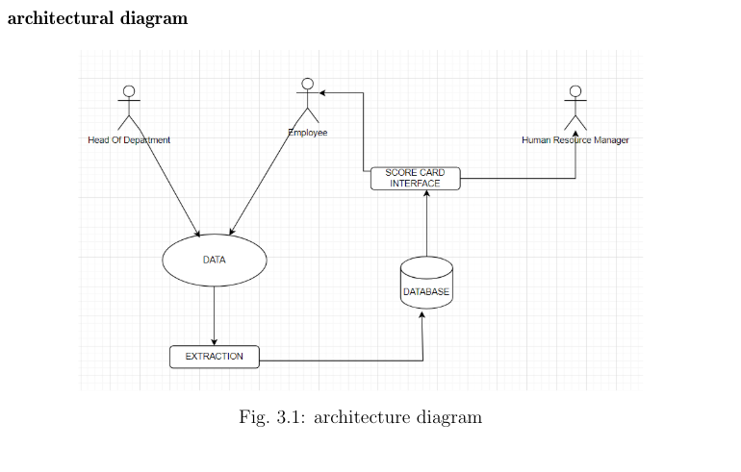
Methodology cont’d
Design
UML diagrams explain the structure & flow

Slide 10
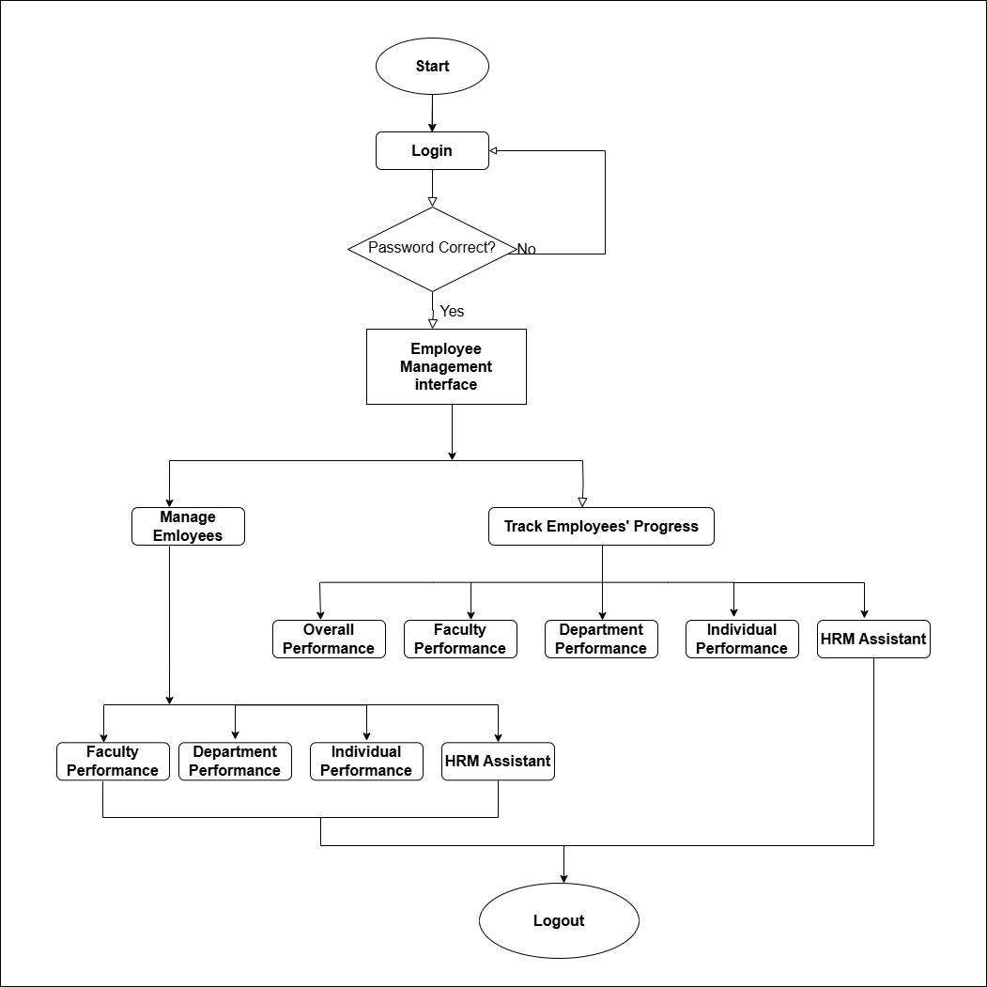
Flow chart

Slide 11
Methodology cont’d
Development
HTML to build the system’s structure
CSS to style the interface
PHP & JavaScript to extract data from CSV files, process and forecast employee performance
MySQL for database management,

Slide 12
References
Mabai, Z. and Hove, G., 2020. Factors affecting organizational performance: a case of a human settlement department in South Africa. Open Journal of Business and Management, 8(06), p.2671.
Tomczak, D.L., Lanzo, L.A. and Aguinis, H., 2018. Evidence-based recommendations for employee performance monitoring. Business Horizons, 61(2), pp.251-259.
Mbarara University of Science and Technology. Mbarara university of science technology > mission and vision. Available at : https://www.must.ac.ug/mission-and-vision/. Accessed 2024
Stewart, G.L. and Brown, K.G., 2019. Human resource management. John Wiley & Sons.
Karova, M., 2022. Desktop Information System for Employee Management. Machines. Technologies. Materials., 16(9), pp.318-320
Huber, S., 2021. ERP software system comparison between Odoo and Microsoft Dynamics NAV.
Gómez-Llanez, C.Y., Diaz-Leal, N.R. and Angarita Sanguino, C.R., 2020. A comparative analysis of the ERP tools, Odoo and Openbravo, for business management. Aibi Revista de Investigação, 8(3 (2020)), pp.145-153.
Ray, A.K. and Ramesh, D.B., 2016. Human Resource Management Information System (HRMIS) in Libraries-A Case Study Using Orange HRM. Pearl: A Journal of Library and Information Science, 10(3), pp.155-160.

Slide 13


